Slide 1

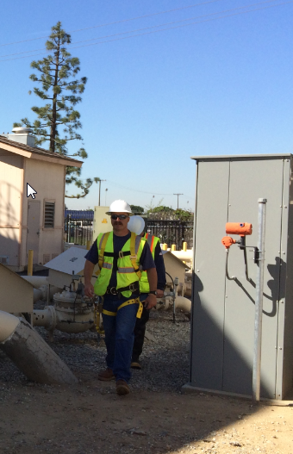
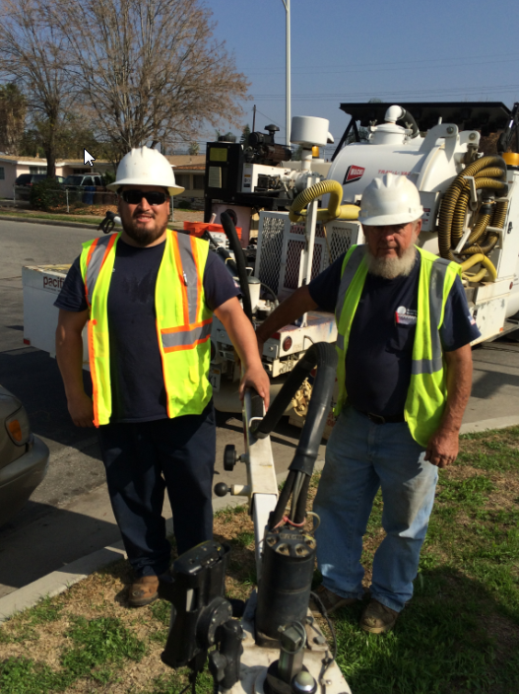
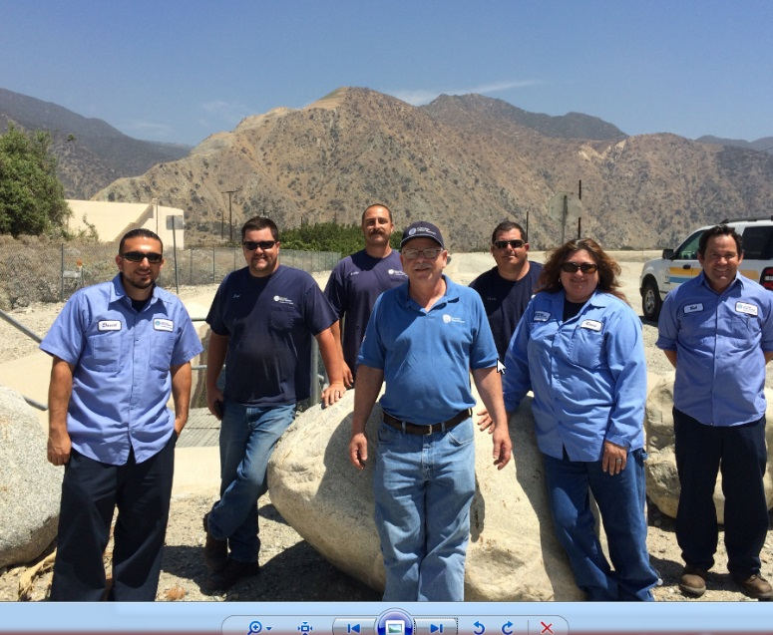
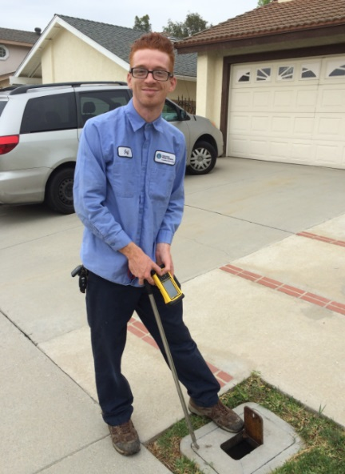
Stewards of the Environment

Slide 2

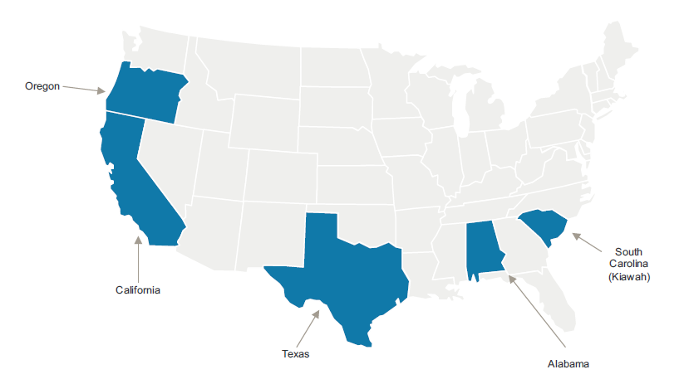

Suburban Water Systems is a wholly owned subsidiary of SouthWest Water Company. SouthWest Water Company serves over half a million residential and business customers in five states.
SC

Slide 3
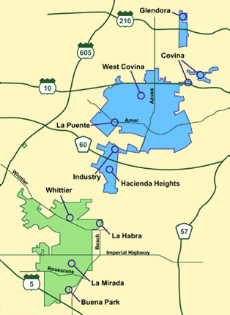
Service Area Snapshot
Suburban Statistics
Employees:
Service area population:
Connections:
Production:
Wells:
Reservoirs:
Booster Pump Stations:
Pipe:
Office Locations:
Covina:
West Covina:
La Mirada:
125
300,000
75,000
43,000 Acre Feet
18 (24,920gpm)
32 (75.1 MG)
36
850 miles
Administration
Operations & Payment
Operations & Payment
San Jose Hills
You are here
Buena Park
City of Industry
Covina
Glendora
Hacienda Heights
La Habra
La Mirada
La Puente
Whittier
Walnut
West Covina
Unincorporated Los Angeles County
Unincorporated Orange County
Whittier / La Mirada

Slide 4
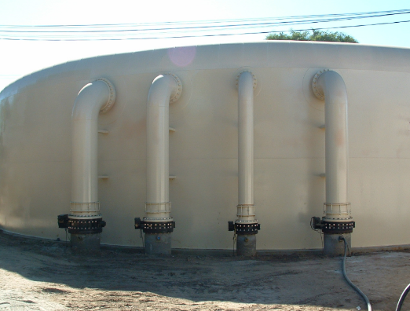
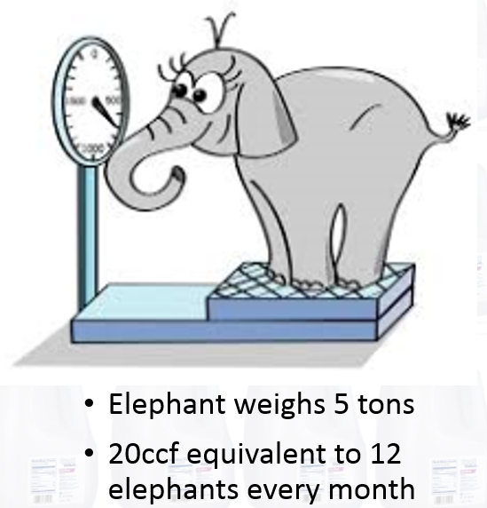

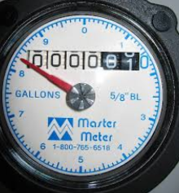
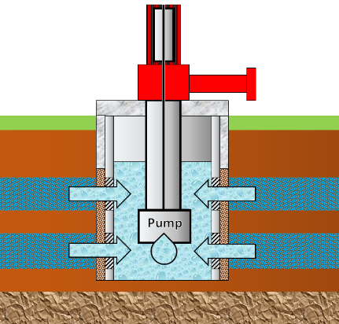

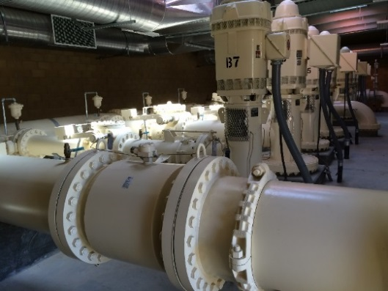
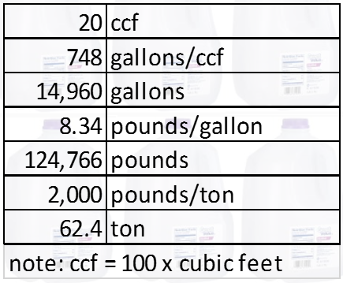
How we get the water to our customer’s home.
TANK
Fire Hydrant
TANK
Well
Meter
PUMP
Water Main Pipeline

Slide 5
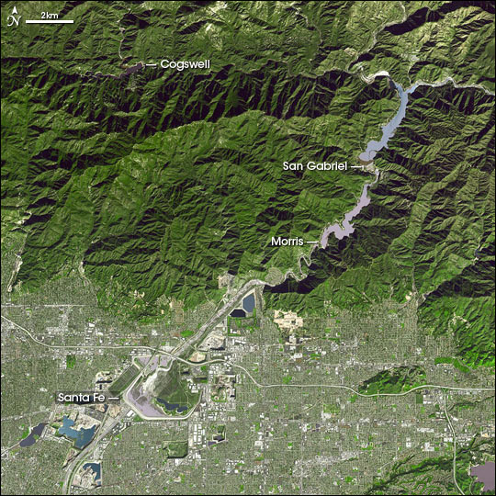
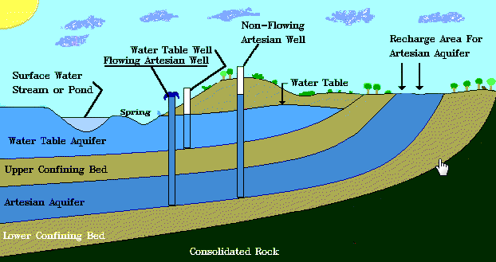
Local Water
Local water comes from rain and snow that falls in San Gabriel River Watershed
Water Stored behind Dam
Spreading Grounds
San Gabriel River
I-210
We store this water in underground groundwater basins
200 wells pump water from the Main San Gabriel Basin

Slide 6
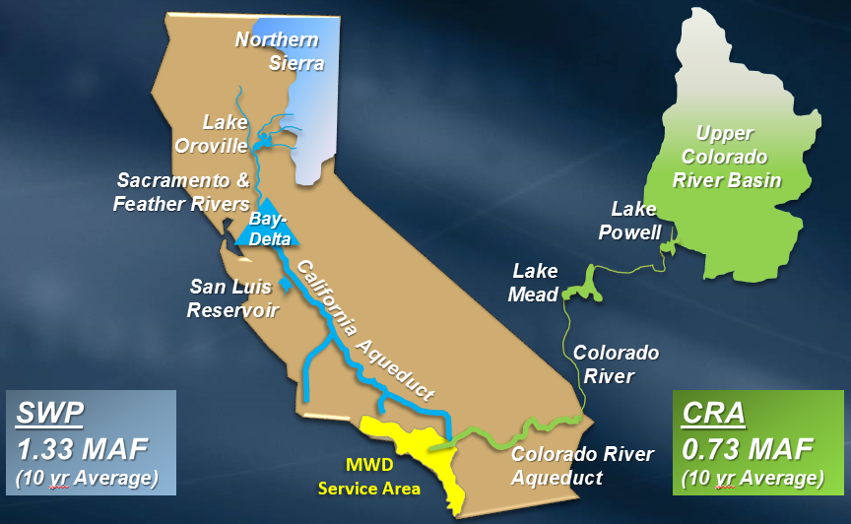
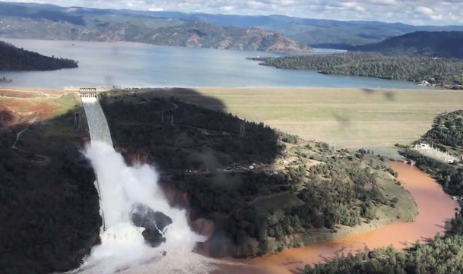
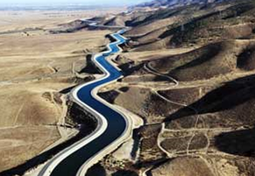
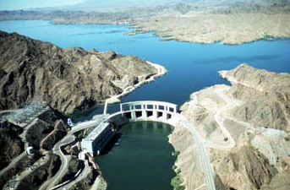
Water from Northern California and the Colorado River is imported by aqueducts
Oroville Dam
Aqueduct
Dam

Slide 7
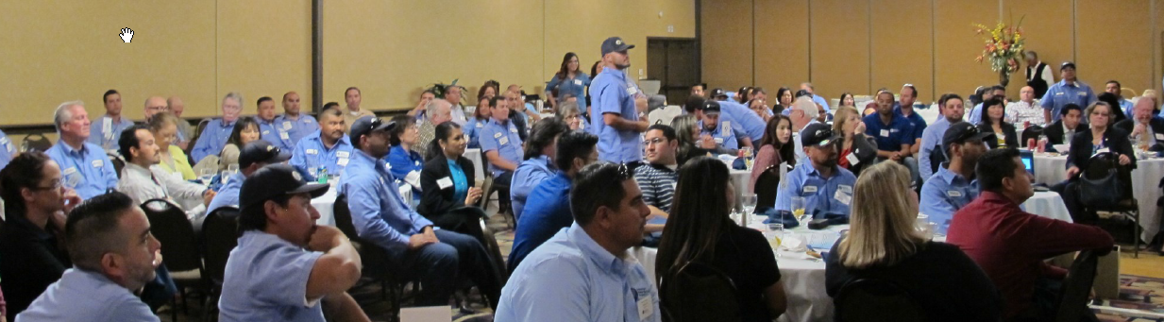
Mission and Values
Mission and Values
Mission: “At Suburban Water Systems, we take great pride in our role as trusted stewards of the world’s most precious resource: WATER”
Values:
Job Safety
Stewardship of the Environment
Customer Care
Employee Success
Community Citizenship

Slide 8

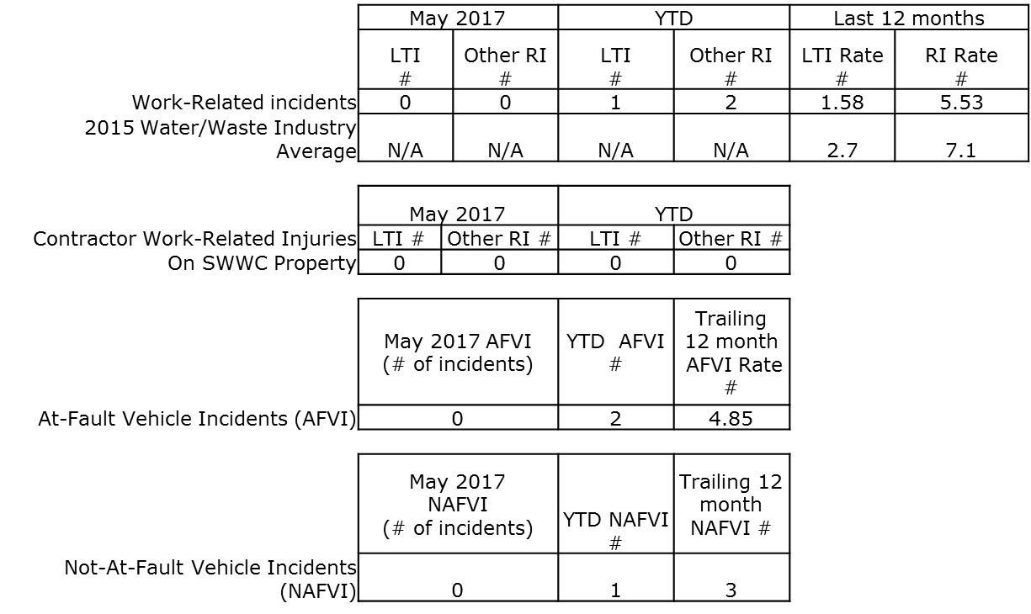
Safety
LTI Rate = Number of Lost Time incidents X 200,000 hours worked / actual hours worked
RI Rate =Total Recordable Incidents (LTI & other RI combined) X 200,000 hours worked / actual hours worked
AFVI Rate = Number At Fault Vehicle incidents X 1,000,000 miles / actual miles driven

Slide 9
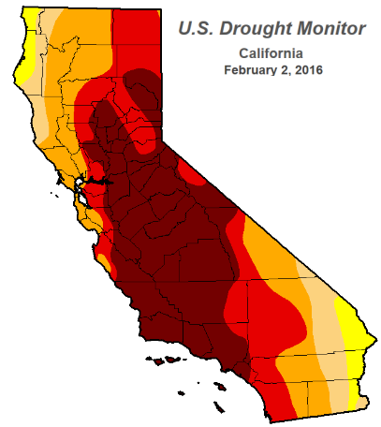
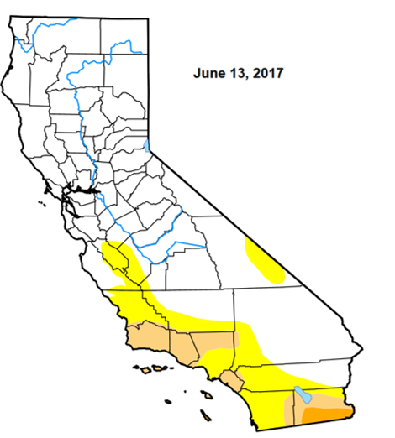
Stewardship of the Environment
April 7, 2017-Govenor Brown declared the drought over
SWRCB-Making Water Conservation a California Way of Life

Slide 10
Stewardship of the Environment

Slide 11
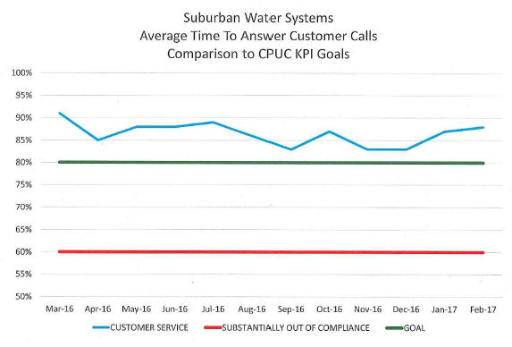

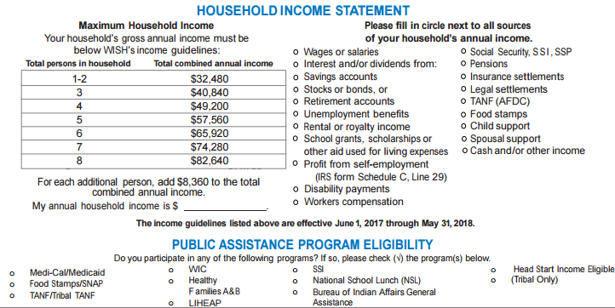
Customer Care
Customer Call Pick-Up Time
WISH- Water Invoice and Statement Help (WISH) program, a low-income rate assistance program for qualifying residential customers.

Slide 12

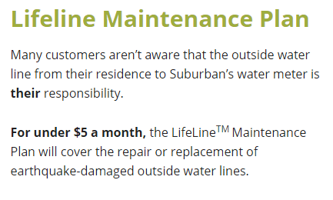
Customer Care

Slide 13

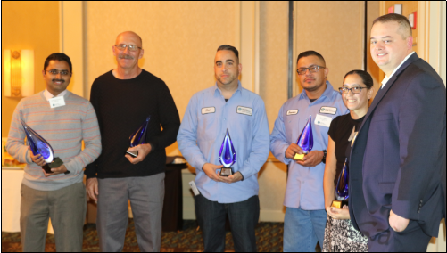
Employee Success
20 people obtained Water and Wastewater Certifications in 2016
Companywide “Voluntary” turnover was 7.9% for 2016 vs 12.2% in 2015.
12 internal promotions in 2016
2016 Missions and Values Awards

Slide 14
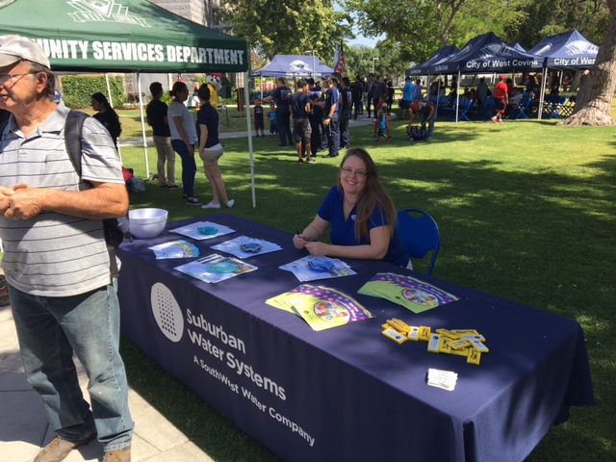
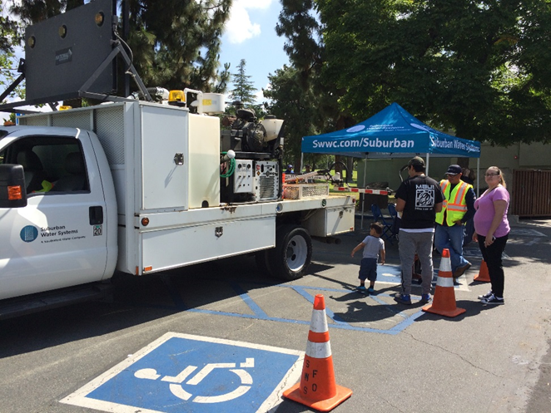
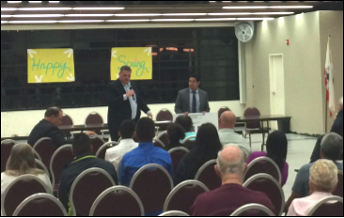
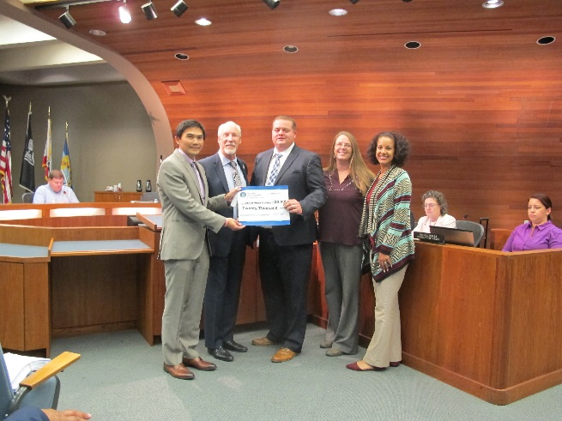
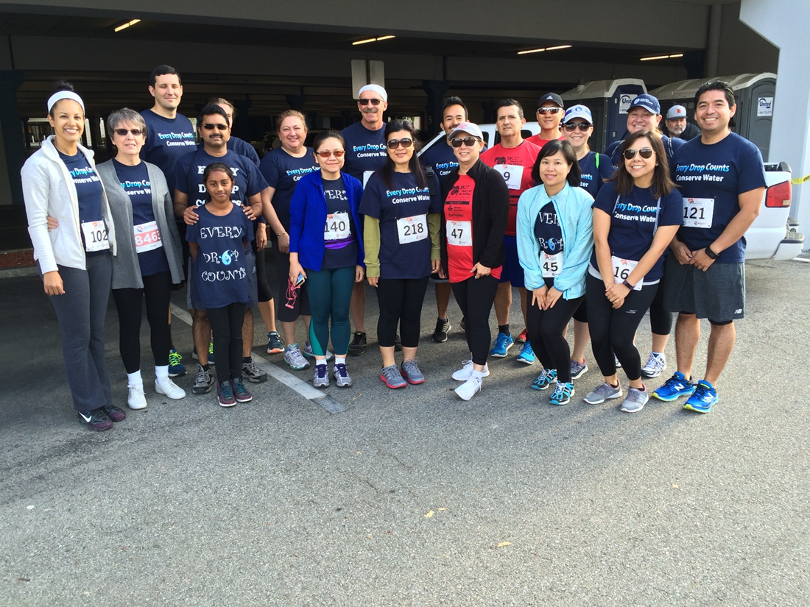
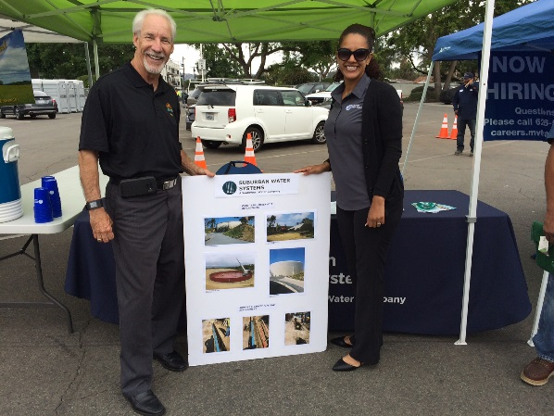
Community Citizenship
2017 So far…
West Covina’s Touch A Truck Event
West Covina Community Meeting
West Covina Earth Day Event
West Covina Heart of the Valley 5k Run/Walk
West Covina Public Works Luncheon
West Covina $20,000 Donation

Slide 15
Mission and Values
Capital Improvement Plan
Project Description | Asset Type | 2017 | 2018 | 2019
Plant 129 Reservoir Replacement | Reservoir | $484,000
Plant 507 R-2 Coating | Reservoir |  | $358,000
Plant 109 Appurtenances | Reservoir |  | $358,000
Jacqueline and Kimberly Service Replacement | Services |  | $327,000
Melissa and Marcella Service Replacement | Services |  |  | $505,000
Orange, Glenmere, Lang, Randall, Forrest | Pipeline |  |  | $1,072,000
Plant 507 R-1 Coating | Reservoir |  |  | $398,959
Total |  | $484,000 | $1,043,000 | $1,975,959

Slide 16
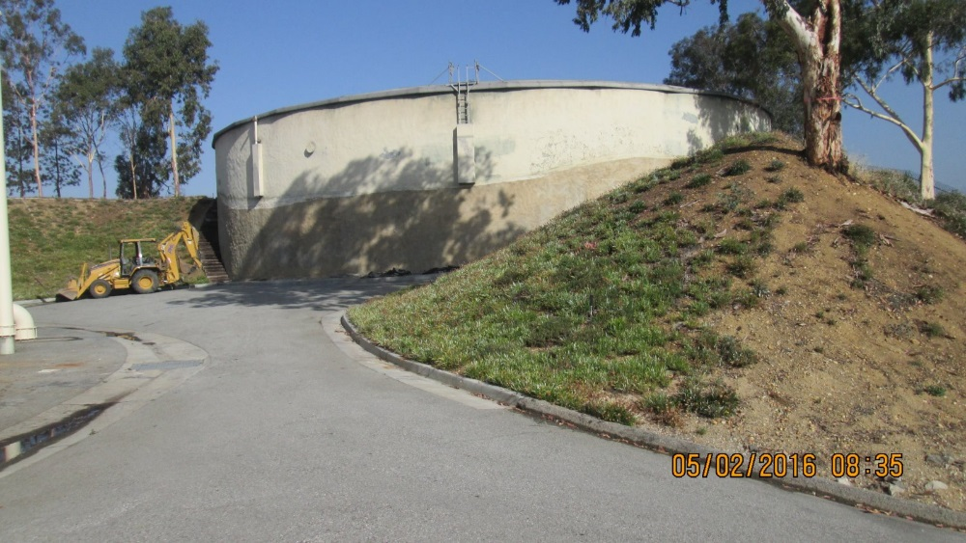
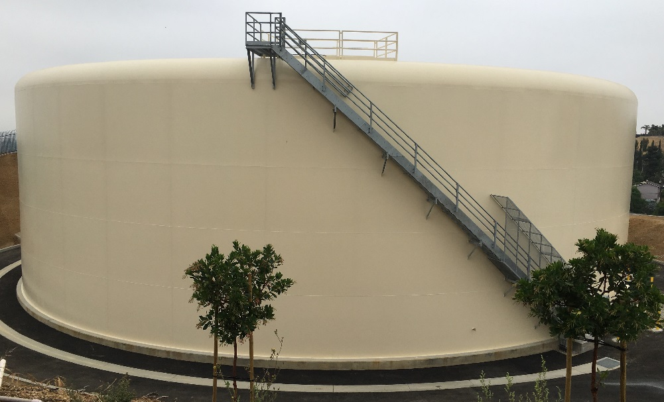
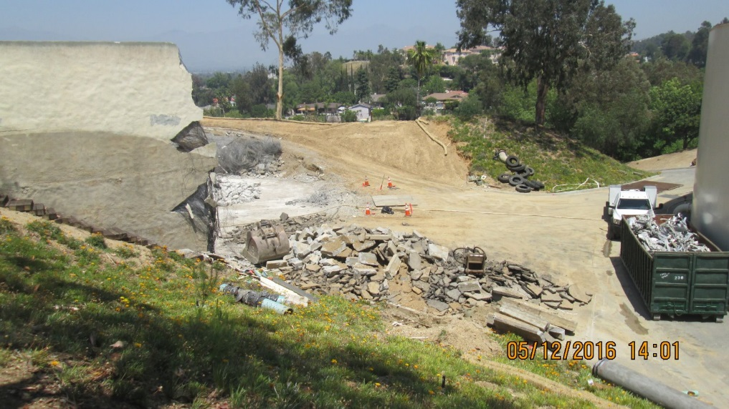
Plant 129
2.5 MG Concrete Reservoir
2.5 MG Steel Reservoir
28,000 Connections
668,335 lbs of dirt removed
472,777 lbs of steel

Slide 17
Regulated by the CPUC
California Public Utilities Commission
The CPUC regulates privately owned electric, natural gas, telecommunications, water, railroad, rail transit, and passenger transportation companies. The CPUC serves the public interest by protecting consumers and ensuring the provision of safe, reliable utility service and infrastructure at just and reasonable rates, with a commitment to environmental enhancement and a healthy California economy.

Slide 18
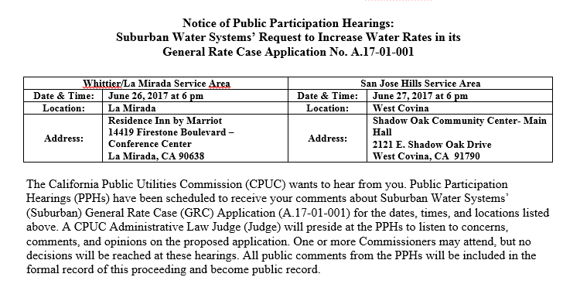
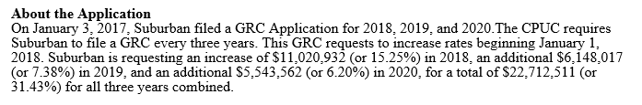
General Rate Case

Slide 19
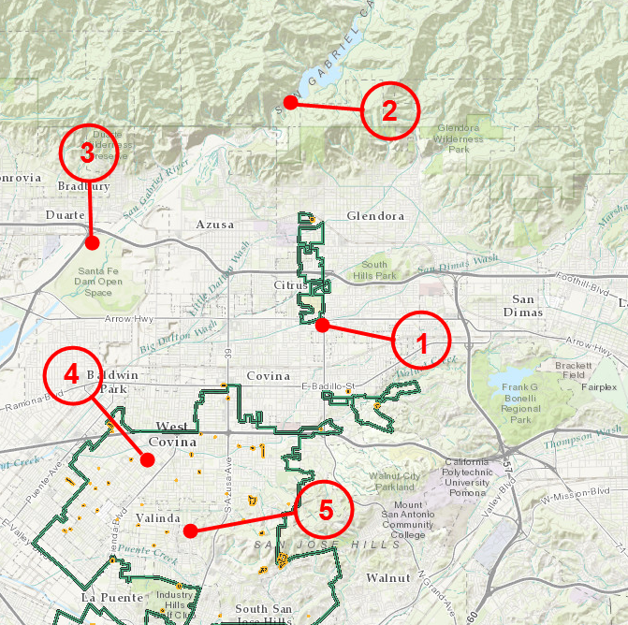
Mission and Values
Site Tour
1.Main Office
2.Morris Dam
3.San Gabriel River Spreading Grounds
4.Plant 121
5.Plant 129

