Slide 1
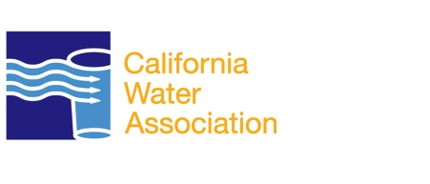
Water Quality Compliance
California Water Association

Slide 2
Water Quality Compliance
The SWDA requires any operating water system to have a water supply permit from the department or the delegated authority.
The Safe Drinking Water Act (SDWA) was originally passed by Congress in 1974 to protect public health by regulating the nation's public drinking water supply.

Slide 3
Water Quality Compliance
California’s own safe drinking water act has two main goals
  to continue the state’s drinking water program, and
  to serve as the primacy agency for enforcement.
SDWA authorizes the USEPA to set national health-based standards for drinking water to protect against both naturally occurring and man-made contaminants that may be found in drinking water.

Slide 4
Water Quality Compliance
All water providers, whether investor-owned water utilities regulated by state public utility commissions or government-owned water utilities must adhere to the same water quality standards, which in California are established by the U.S. Environmental Protection Agency (USEPA) and the California Department of Public Health (CDPH).

Slide 5
Water Quality Compliance
The CDPH’s responsibility for the quality of these drinking water sources begins at the point where water is pumped from a drinking-water well or surface-water intake point.
Before the water is pumped, the State Water Resources Control Board and the Regional Water Quality Control Boards maintain responsibility for the quality of these drinking water sources.

