Slide 1
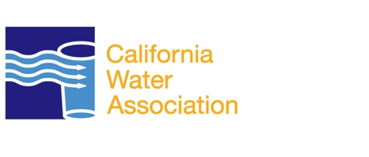
Rate-Making
California Water Association

Slide 2
Input and Oversight
The rates and terms of service provided by private utility companies in California are regulated by the California Public Utilities Commission (CPUC).
The CPUC sets rates that cover the costs of providing service (i.e., labor, electricity, insurance, supplies) and allow a reasonable return (usually about 10%) on shareholder capital invested in water infrastructure.

Slide 3
Factors that Influence Rates
Factors that affect the rates and terms of service of private utilities in California:
  Income and property taxes;
  Developer impact fees;
  Timing and level of investments in local water infrastructure; and
  Operating costs.

Slide 4
Factors that Influence Rates
Additional factors that impact water rates:
  the physical condition of the water system’s components;
  the quality of the water and the extent of treatment required to meet regional, state and federal regulations;
  the level of existing and needed investment; and
  geographic location.

Slide 5
Factors that Influence Rates
All water providers must make system improvements in order to provide a reliable supply of water and to meet increasingly stringent water quality standards.
These system improvements, together with the ongoing costs of utility operations, continue to affect water rates.

Slide 6
The Facts
Water treatment and distribution infrastructure may be owned privately, but the actual water is owned or controlled publicly. A private water utility may also be a publicly traded corporation whose owners are its common stockholders.

Slide 7
The Facts
Investor-owned water utilities that have multiple service areas can often offer cost savings by centralizing and sharing the costs of certain services, such as engineering, water quality testing, and administrative services.

Slide 8
The Facts
A 2005 UC Santa Barbara study found that among water providers in the Thousand Oaks area, private water utilities tended to have more efficient and less costly operations.
Municipal water suppliers tended to have lower rates, due in large part to tax-exempt financing, no income or property taxes, and other similar advantages not available to private utility providers.

