Slide 1
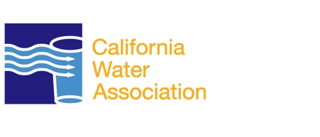
Public-Private Partnerships
California Water Association

Slide 2
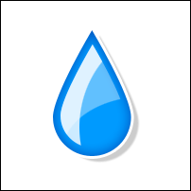
The Facts
1 in of 4 people in the US receive water service from a privately owned water utility or a municipal utility operating under a public-private partnership.
Whether water service is provided by municipally owned and operated utilities, privately owned and operated utilities or public-private partnerships, the ultimate control of the water itself stays in public hands.

Slide 3
The Facts
Private water companies own nearly 16 percent of the nation’s community water systems, and around 2,000 government entities contract with private companies to provide water and/or wastewater service in a public-private partnership.
Contracts for public-private partnerships are renewed at an average rate of 93 percent, underscoring the satisfaction with the resulting services.

Slide 4
The Facts
All water utilities are subject to extensive government oversight, which establishes and enforces health and environmental regulations while also making long-term water resource allocation decisions.
No matter what the model — public or private —the true cost of service drives water rates, and the largest contributing factor is capital investment needed to ensure reliable service.

