Slide 1
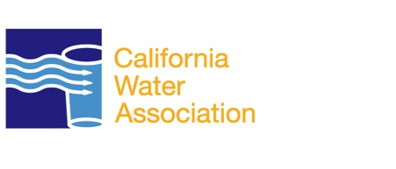
Customer Service and Satisfaction
California Water Association

Slide 2
Customer Service and Satisfaction
Privately owned and operated water utilities, or Investor-Owned have successfully served the water supply needs of American communities for more than 150 years.
The fact that more than 93 percent of public-private partnerships are renewed annually indicates that that the vast majority of customers are satisfied with the service provided by investor-owned water service. providers.

Slide 3
Customer Service and Satisfaction
When municipalities work in tandem with IOUs, the end result is likely to be more efficiency and a better value for customers.
IOUs promote water efficiency and environmentally sound business practices. As water providers, they understand the responsibility entrusted to them for delivering an essential and limited resource

Slide 4
Customer Service and Satisfaction
IOUs promote water efficiency and environmentally sound business practices.
As water providers, they understand the responsibility entrusted to them for delivering an essential and limited resource.
IOUs implement best management practices to minimize waste, maximize human resources and increase productivity.

Slide 5
Customer Service and Satisfaction
A public-private water system works to the customer’s advantage, with the private partner taking on virtually all of the risk, and the municipality and customer taking on very little.

